Slide 1
STM32F401CCU6 ADC
ARM Cortex M4 Series MCU

Slide 2
ADC Introduction
The 12-bit ADC is a successive approximation analog-to-digital converter.
It has up to 19 multiplexed channels allowing it to measure signals from 16 external sources, two internal sources, and the VBAT channel.
The A/D conversion of the channels can be performed in single, continuous, scan or discontinuous mode.
The result of the ADC is stored into a left or right-aligned 16-bit data register.
ADC2 and ADC3 are not available in STM32F401ccu6

Slide 3
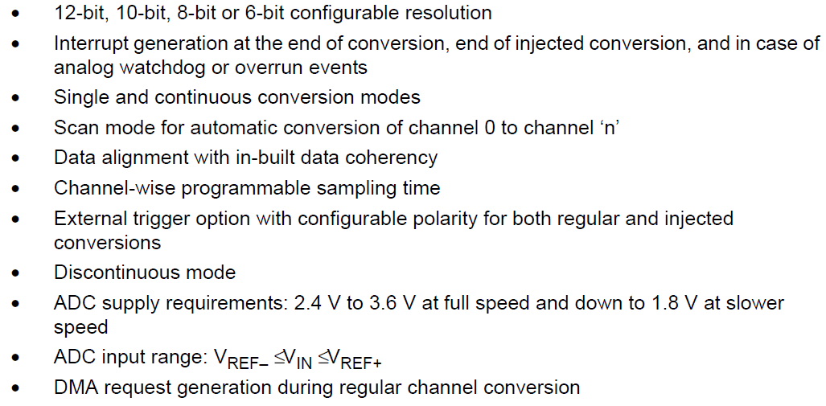
ADC main features
ADC2 and ADC3 are not available in STM32F401ccu6

Slide 4
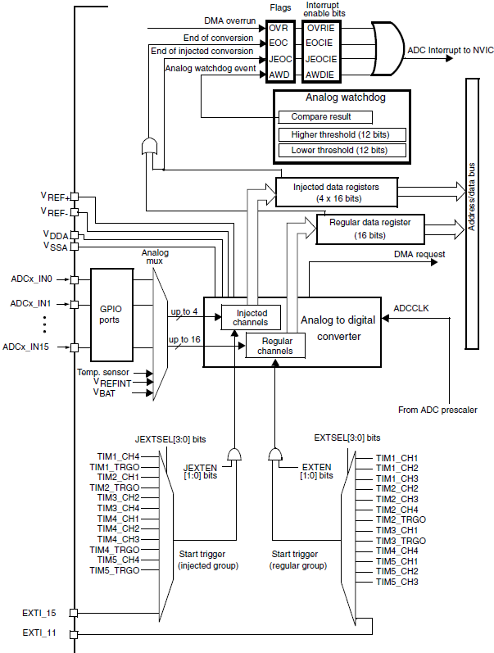
Single ADC block diagram
The ADC has 16 external channels (ADCx_IN0 to ADCx_IN15) and multiple internal channels, such as temperature sensors and reference voltages.
These inputs are connected to a multiplexer that selects which channel to sample during the conversion cycle.
The channel is selected by programming the ADC_SQRx registers.

Slide 5
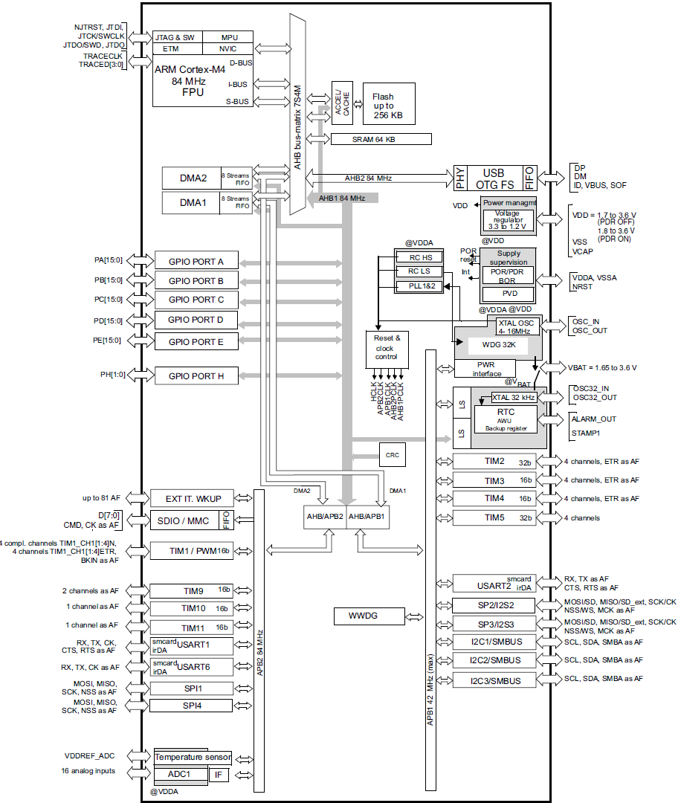
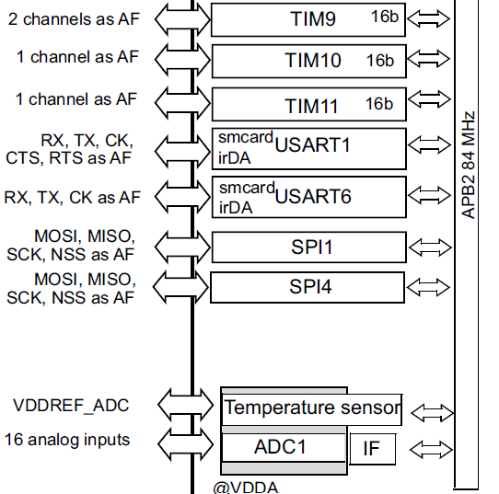
ADC Block Diagram

Slide 6
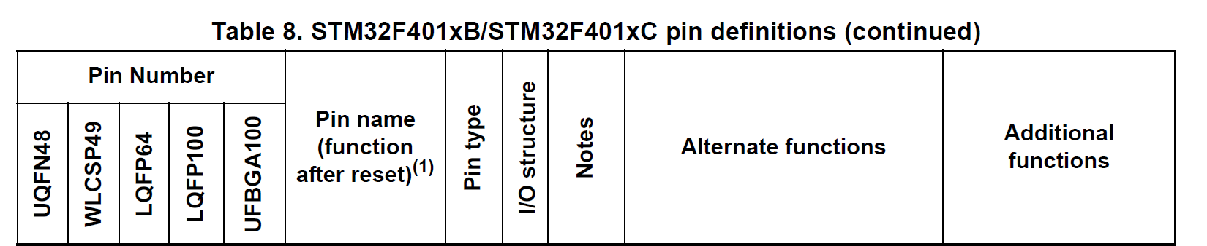
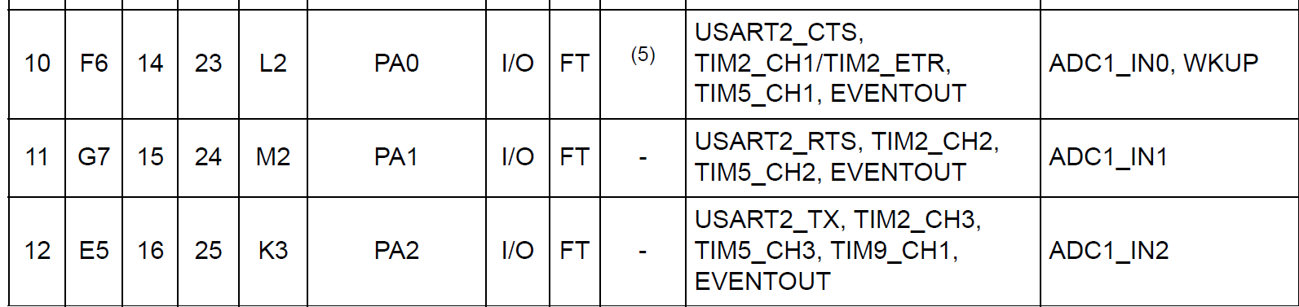

Slide 7
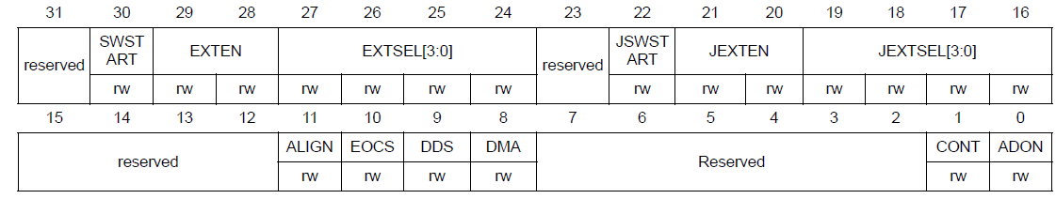
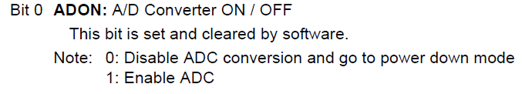
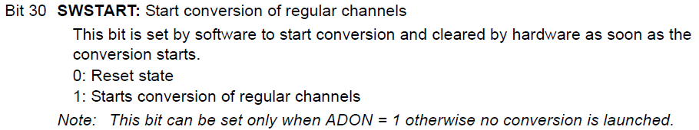
ADC on-off control
The ADC is powered on by setting the ADON bit in the ADC_CR2 register.
When the ADON bit is set for the first time, it wakes up the ADC from the Power-down mode.
Conversion starts when either the SWSTART or the JSWSTART bit is set.
You can stop conversion and put the ADC in power down mode by clearing the ADON bit.
Bit 1 CONT : Continuous conversion
This bit is set and cleared by software.
0: Single conversion mode
1: Continuous conversion mode

Slide 8
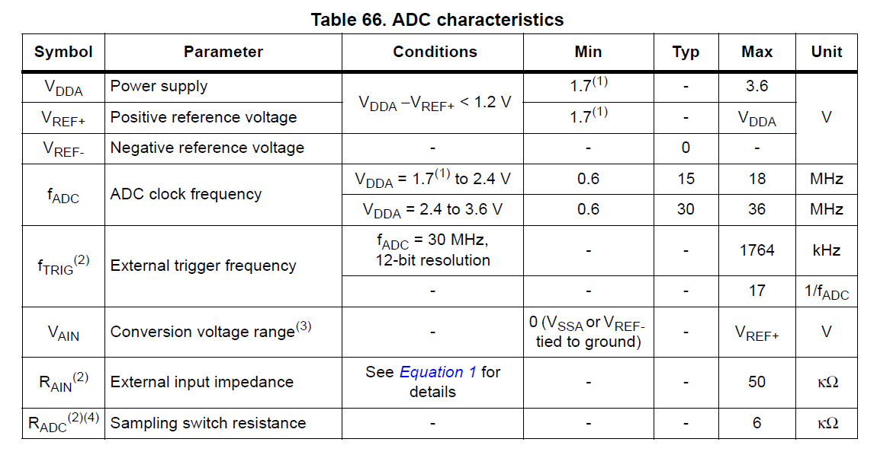
ADC clock
The maximum ADC clock frequency is 36 MHz for accurate conversions.
When configuring the clock, always ensure that the ADC clock (after prescaling) does not exceed this maximum frequency to avoid erroneous readings.

Slide 9
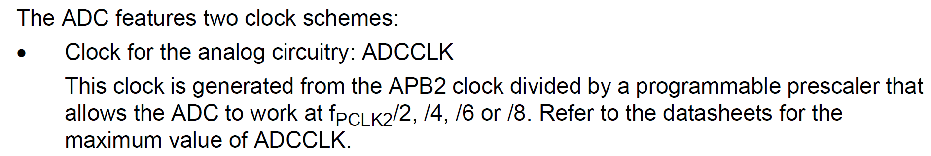
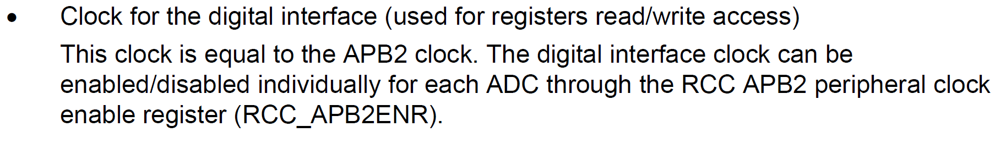
ADC clock Cont.
The maximum ADC clock frequency is 36 MHz for accurate conversions.
When configuring the clock, always ensure that the ADC clock (after prescaling) does not exceed this maximum frequency to avoid erroneous readings.

Slide 10
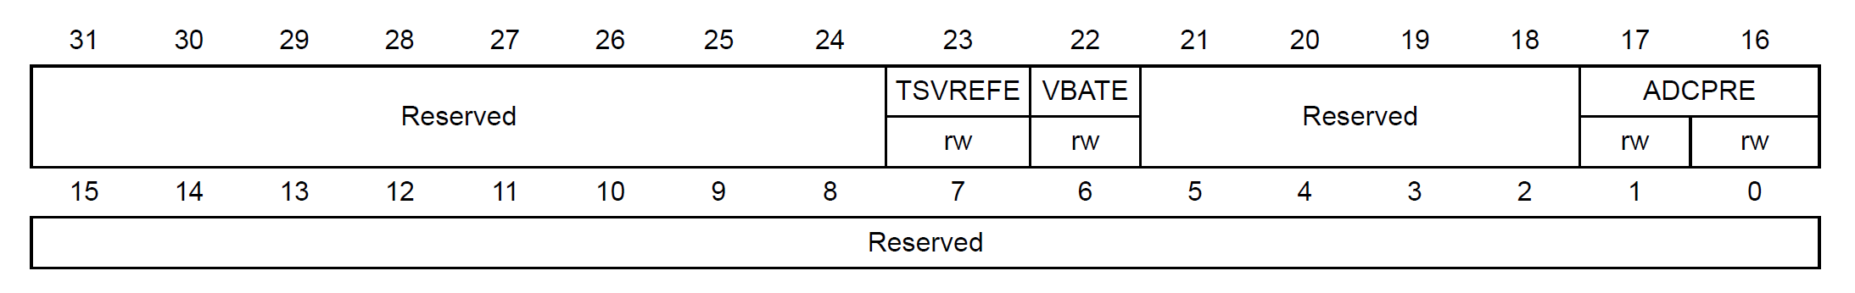
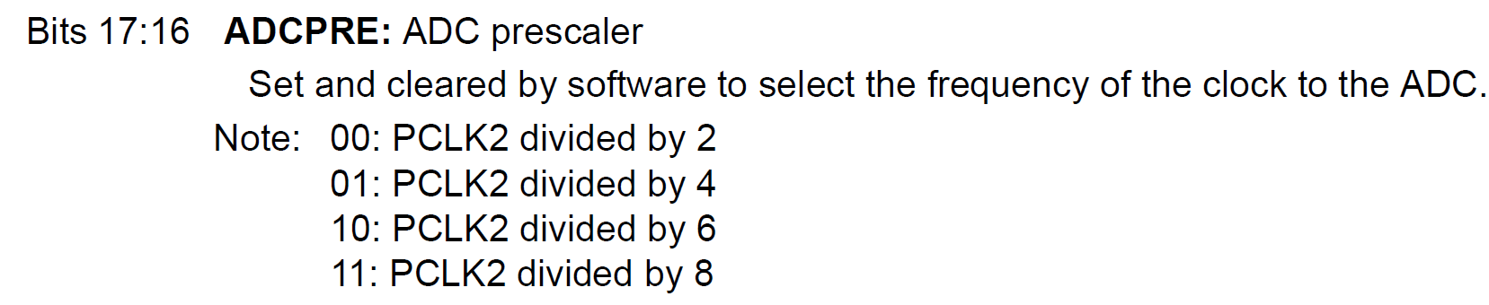
ADC clock Cont.
ADC common control register (ADC_CCR)

Slide 11
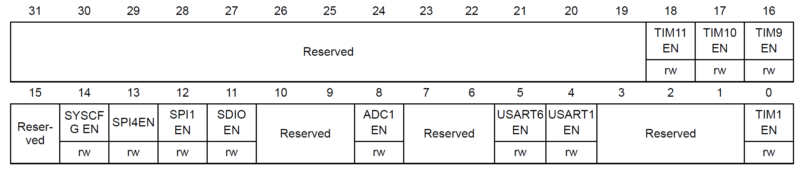
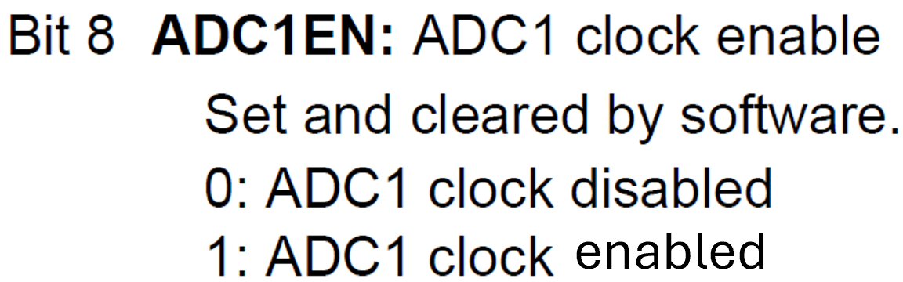
ADC clock Cont.
RCC APB2 peripheral clock enable register(RCC_APB2ENR)

Slide 12
Channel selection
There are 16 multiplexed channels. It is possible to organize the conversions in two groups: regular and injected.
A group consists of a sequence of conversions that can be done on any channel and in any order.
For instance, it is possible to implement the conversion sequence in the following order: ADC_IN3, ADC_IN8, ADC_IN2, ADC_IN2, ADC_IN0, ADC_IN2, ADC_IN2, ADC_IN15.
A regular group is composed of up to 16 conversions.
The regular channels and their order in the conversion sequence must be selected in the ADC_SQRx registers.
The total number of conversions in the regular group must be written in the L[3:0] bits in the ADC_SQR1 register.

Slide 13
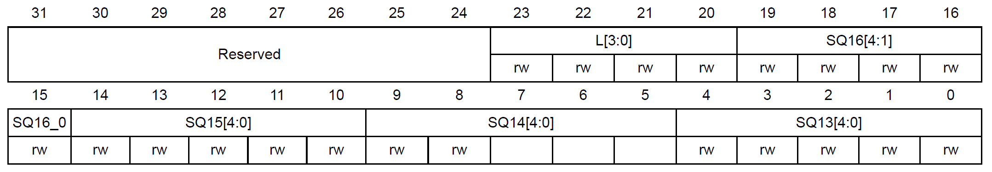
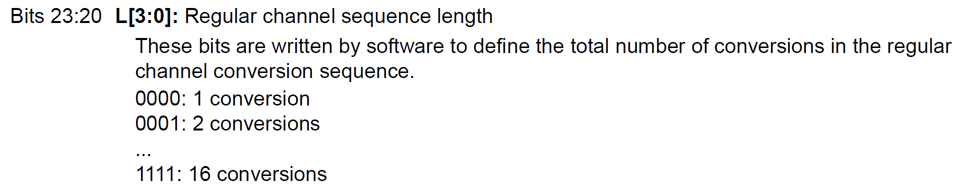
ADC regular sequence register 1 (ADC_SQR1)

Slide 14
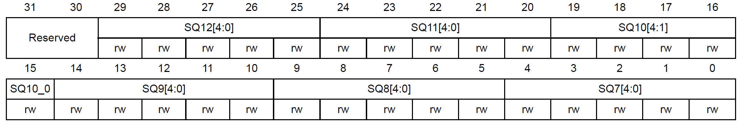
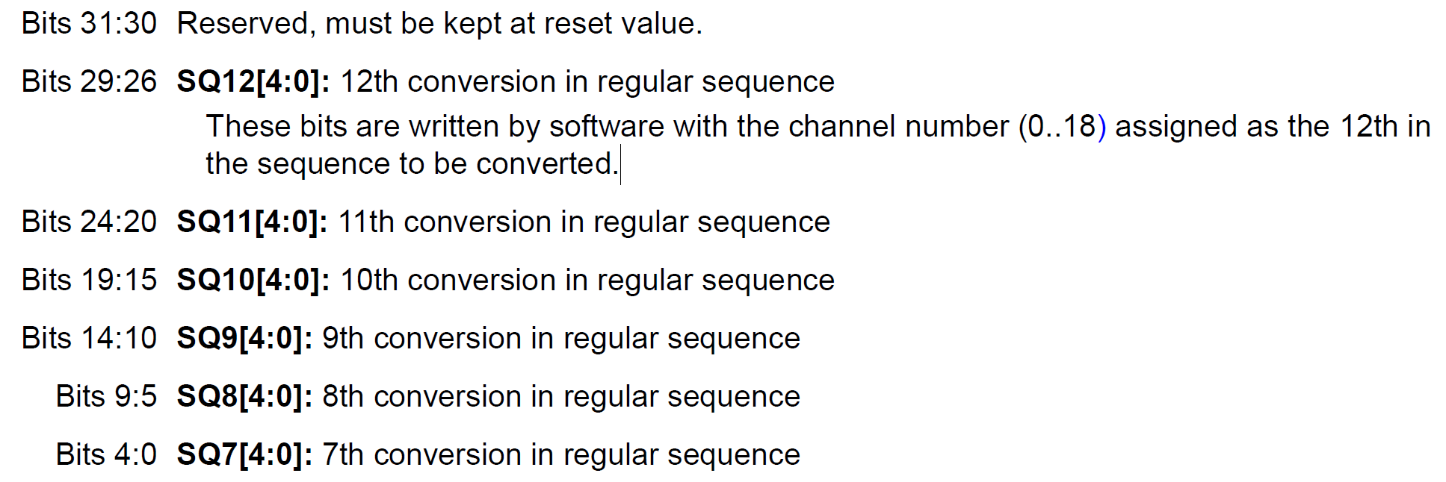
ADC regular sequence register 2 (ADC_SQR2)

Slide 15
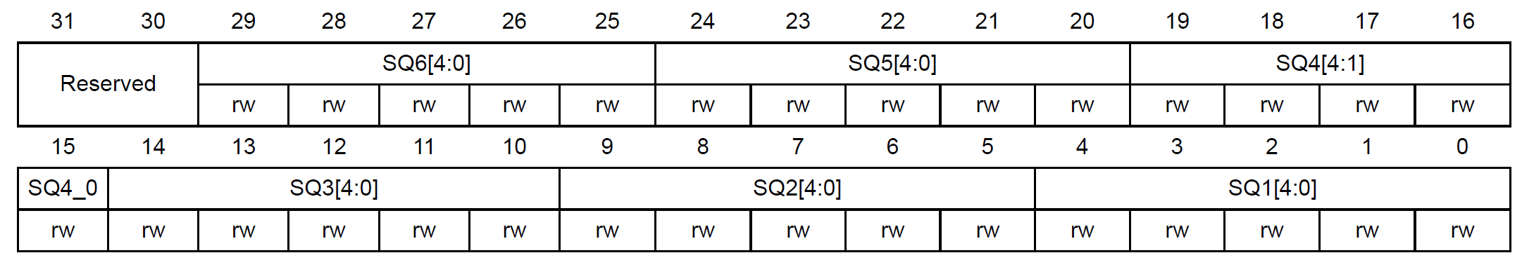
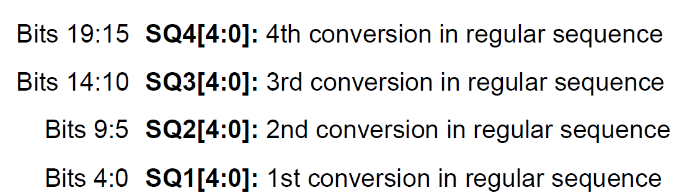
ADC regular sequence register 3 (ADC_SQR3)

Slide 16
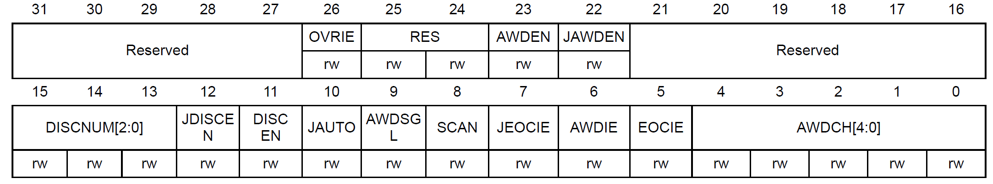
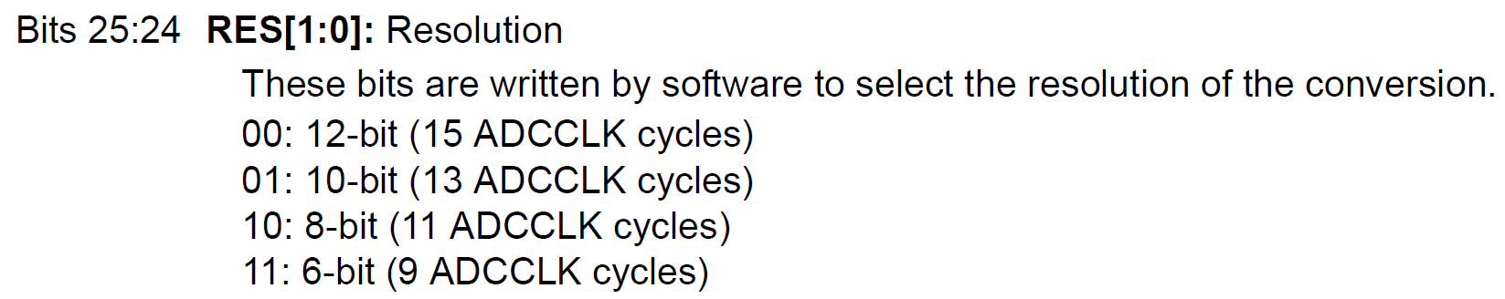
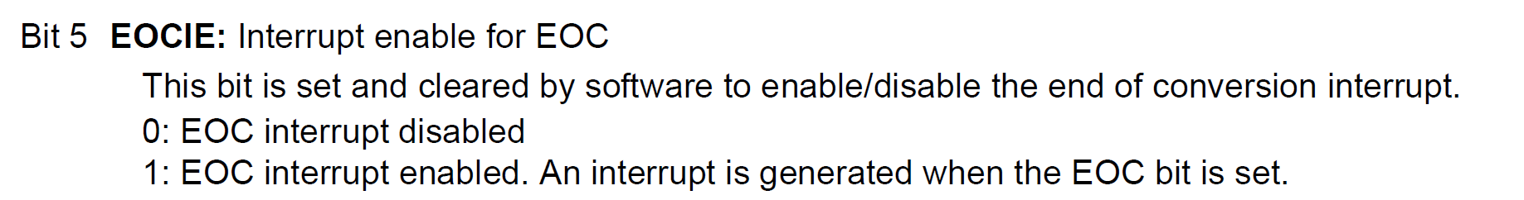
ADC control register 1 (ADC_CR1)

Slide 17
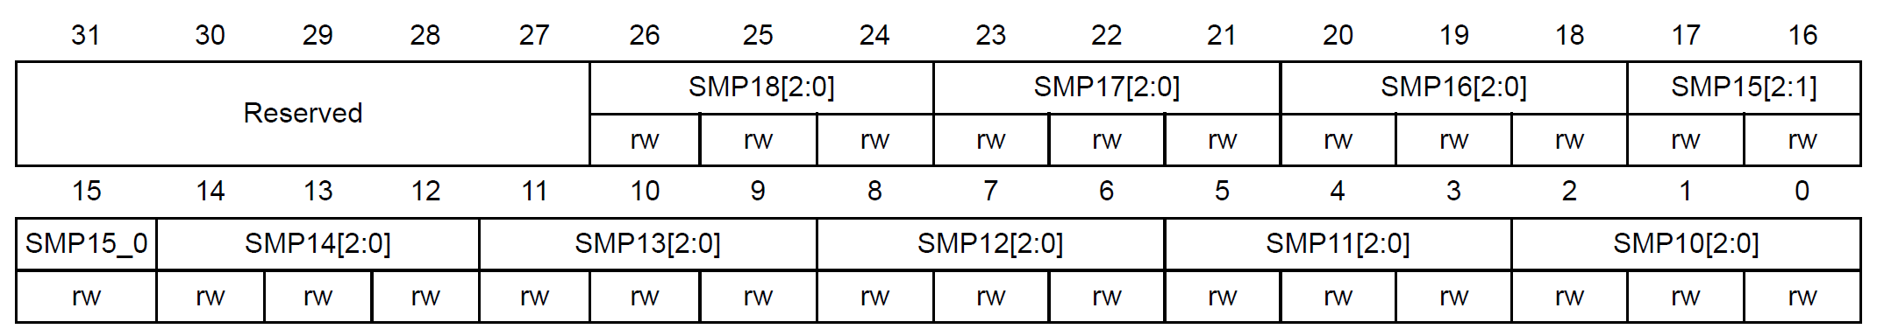
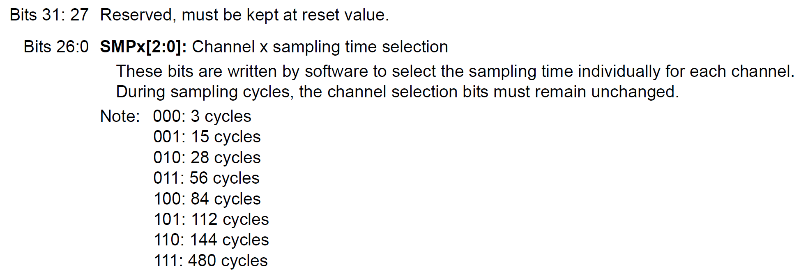
ADC sample time register 1 (ADC_SMPR1)

Slide 18
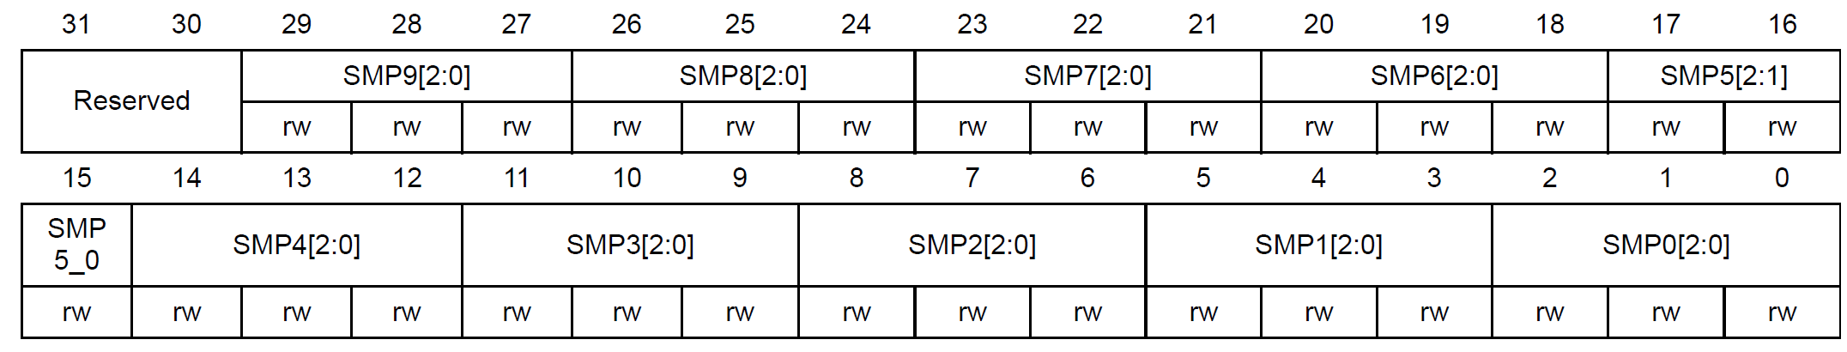
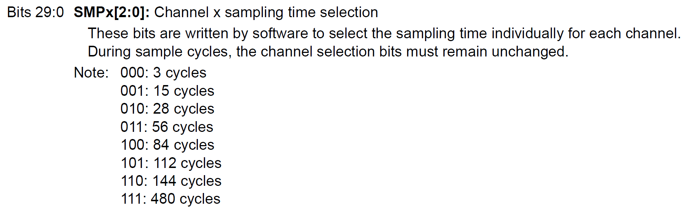
ADC sample time register 2 (ADC_SMPR2)

Slide 19
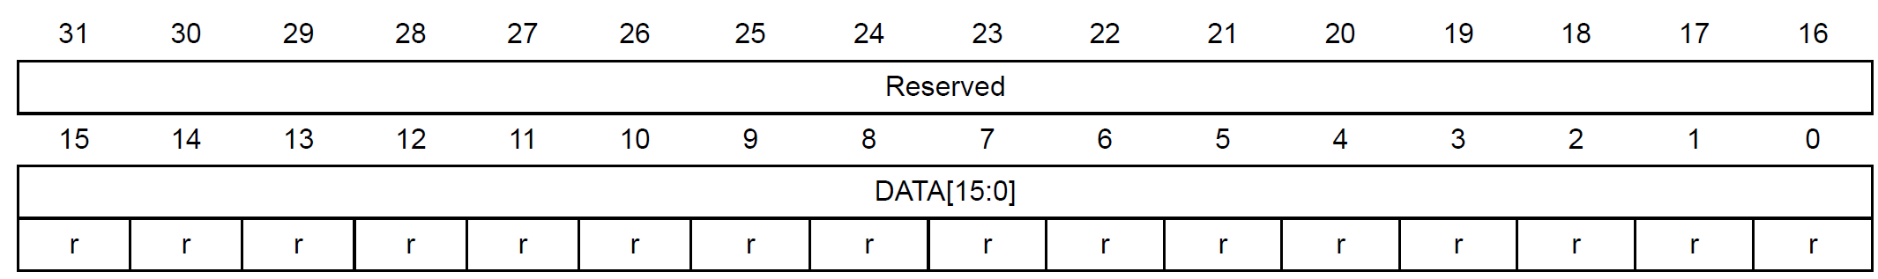
ADC regular data register (ADC_DR)
Bits 15:0 DATA[15:0]: Regular data
These bits are read-only.
They contain the conversion result from the regular channels.

Slide 20
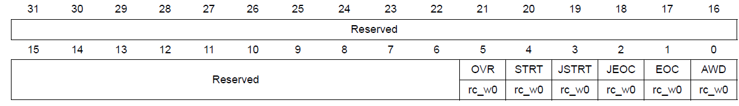
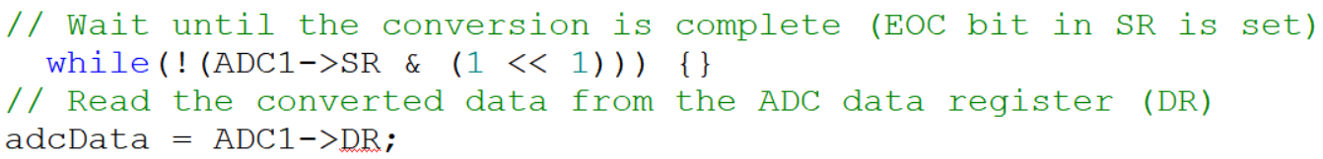
ADC status register (ADC_SR)
Bit 1 EOC: Regular channel end of conversion
This bit is set by hardware at the end of the conversion of a regular group of channels. It is cleared by software or by reading the ADC_DR register.
0: Conversion not complete or sequence of conversions not complete
1: Conversion complete or sequence of conversions complete

Slide 21
The ADC resolution can be defined as the smallest input voltage at the analog pin that an ADC can identify and increments its digital value. The maximum and minimum digital output value of ADC depends on the number of bits of the ADC. 3. For example, for a 8-bit ADC, the digital output value will be between 0-255, for a 10-bit ADC, the digital output value will be between 0-1023 and for a 12-bit ADC, the digital output value will be between 0-4095.
ADC Resolution
Resolution = (Operating voltage of ADC ) / 2^(number of bits ADC)
The operating voltage of STM32F401 series microcontroller is 3.3V and if we configure the ADC in 12-bit mode:
Resolution = 3.3V/2^12 = 3.3/4095 = 0.8mV
Therefore, for every 0.8mV on ADC input, the digital value will increment and if we apply 3.3V to the input pin of ADC, the digital output value of ADC will be 4095.
Similarly, if we measured a digital value of ADC with an STM32F401 microcontroller, we can convert it back into a voltage by multiplying it with the resolution value.
For example, the measured digital output value is 3500, we can convert it into a voltage by multiplying it by 0.8mV.
Input Voltage = 3500 x 0.8mV = 2800mV or 2.8V
ADC resolution can be defined as :

Slide 22
Interfacing a Potentiometer with STM32F401 ADC on PA0 (Channel 0)
Experiment 4.1

Slide 23
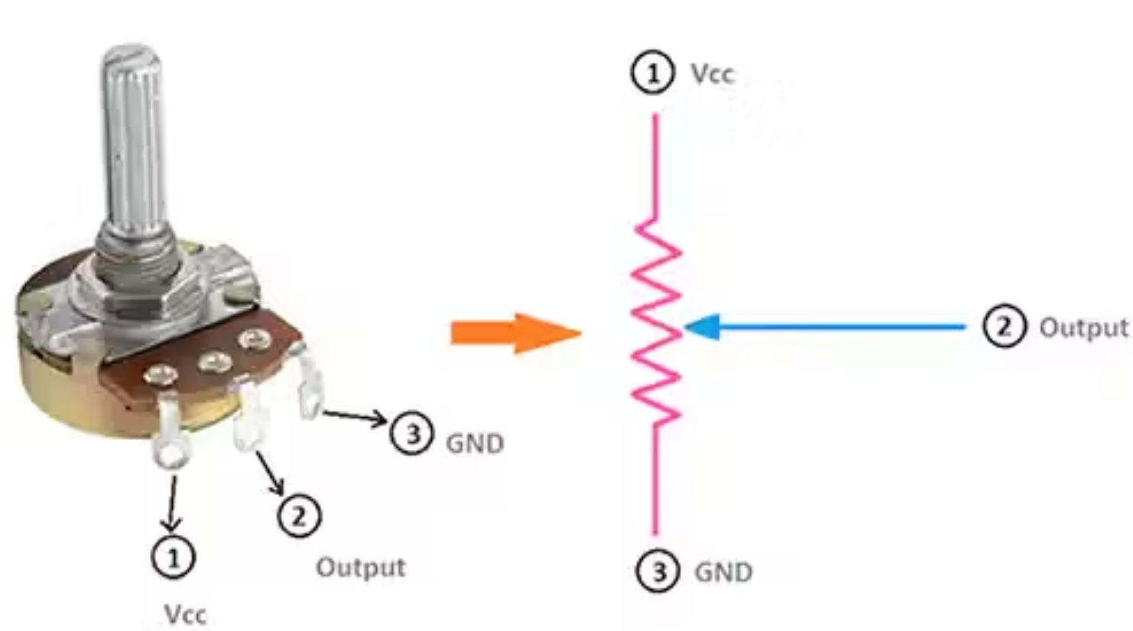
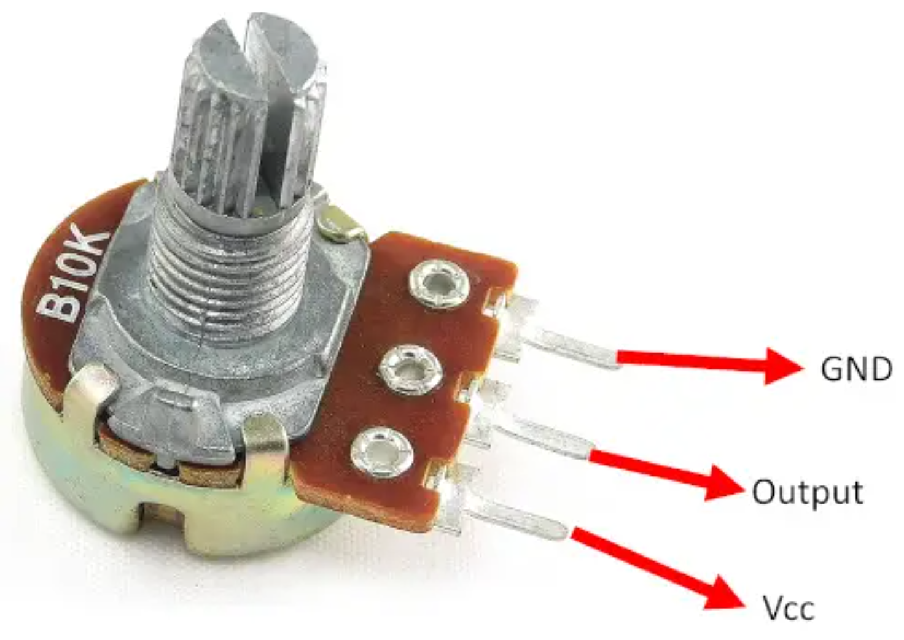
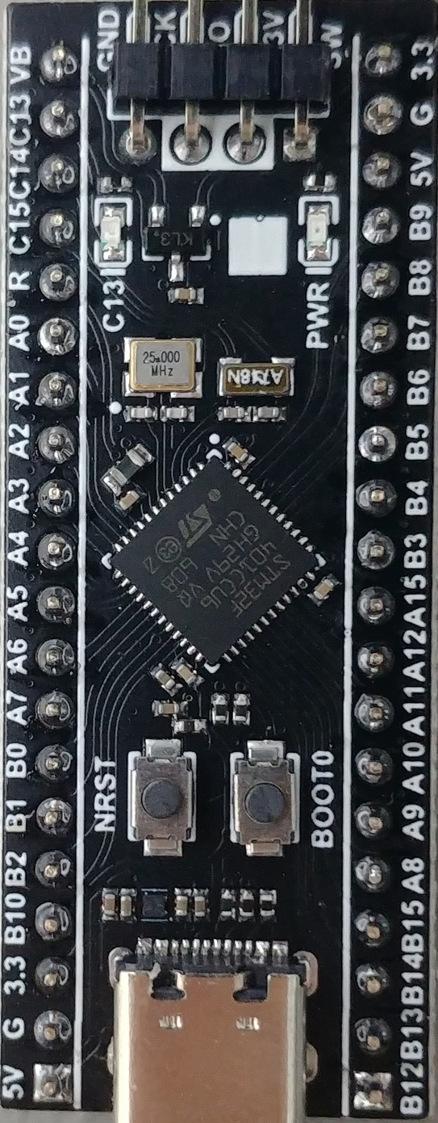
Experiment 4.1
The potentiometer is basically a variable resistor.
It has a total of 3 Terminals, where the outermost terminals need to be connected to VCC and GND, and the terminal in the middle will give us our analog output.
It consists of a knob that is turned to control the resistance value of the potentiometer, this value of resistance will, in turn, affect the voltage drop across it, and that voltage will act as our analog value which needs to be converted into a digital form.

Slide 24
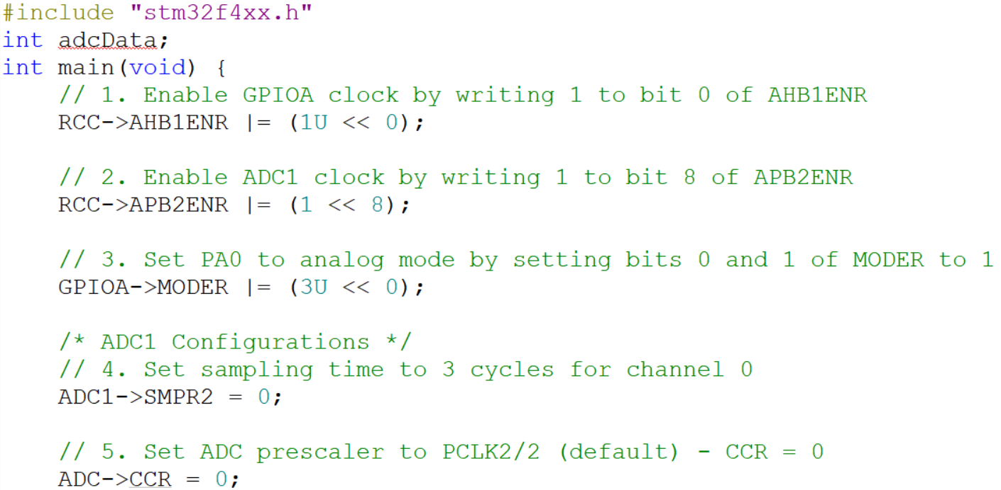
Interfacing a Potentiometer with STM32F401 ADC on PA0 (Channel 0)

Slide 25
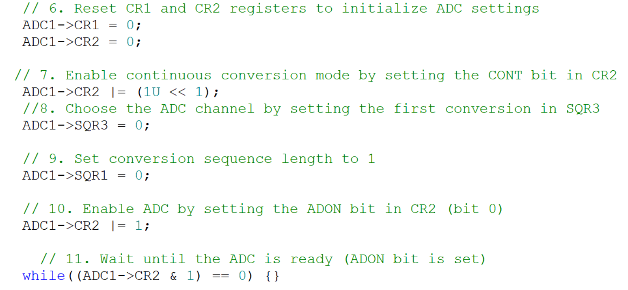
Interfacing a Potentiometer with STM32F401 ADC on PA0 (Channel 0)

Slide 26
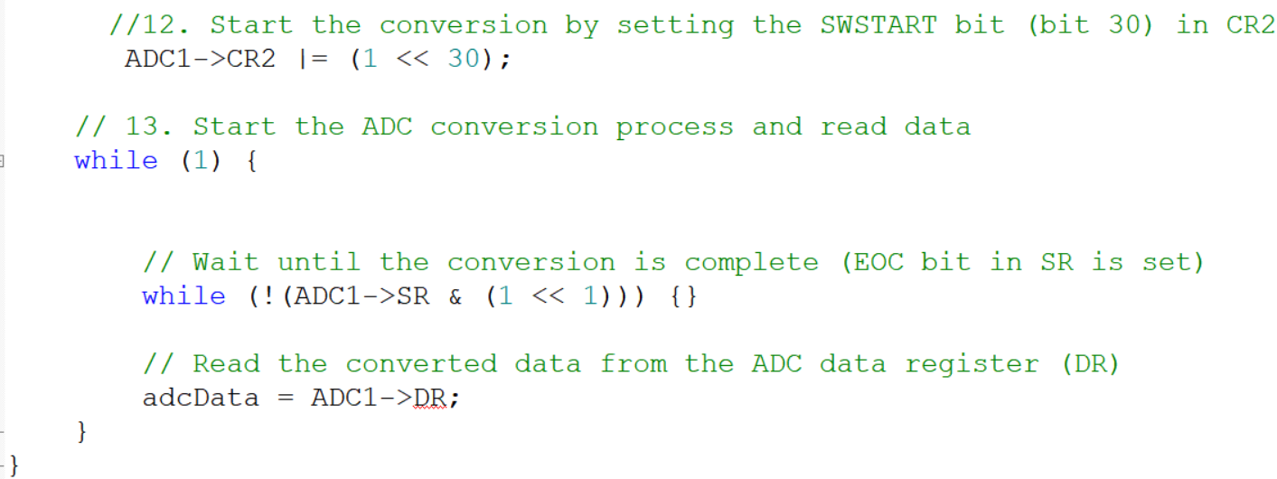
Interfacing a Potentiometer with STM32F401 ADC on PA0 (Channel 0)

Slide 27
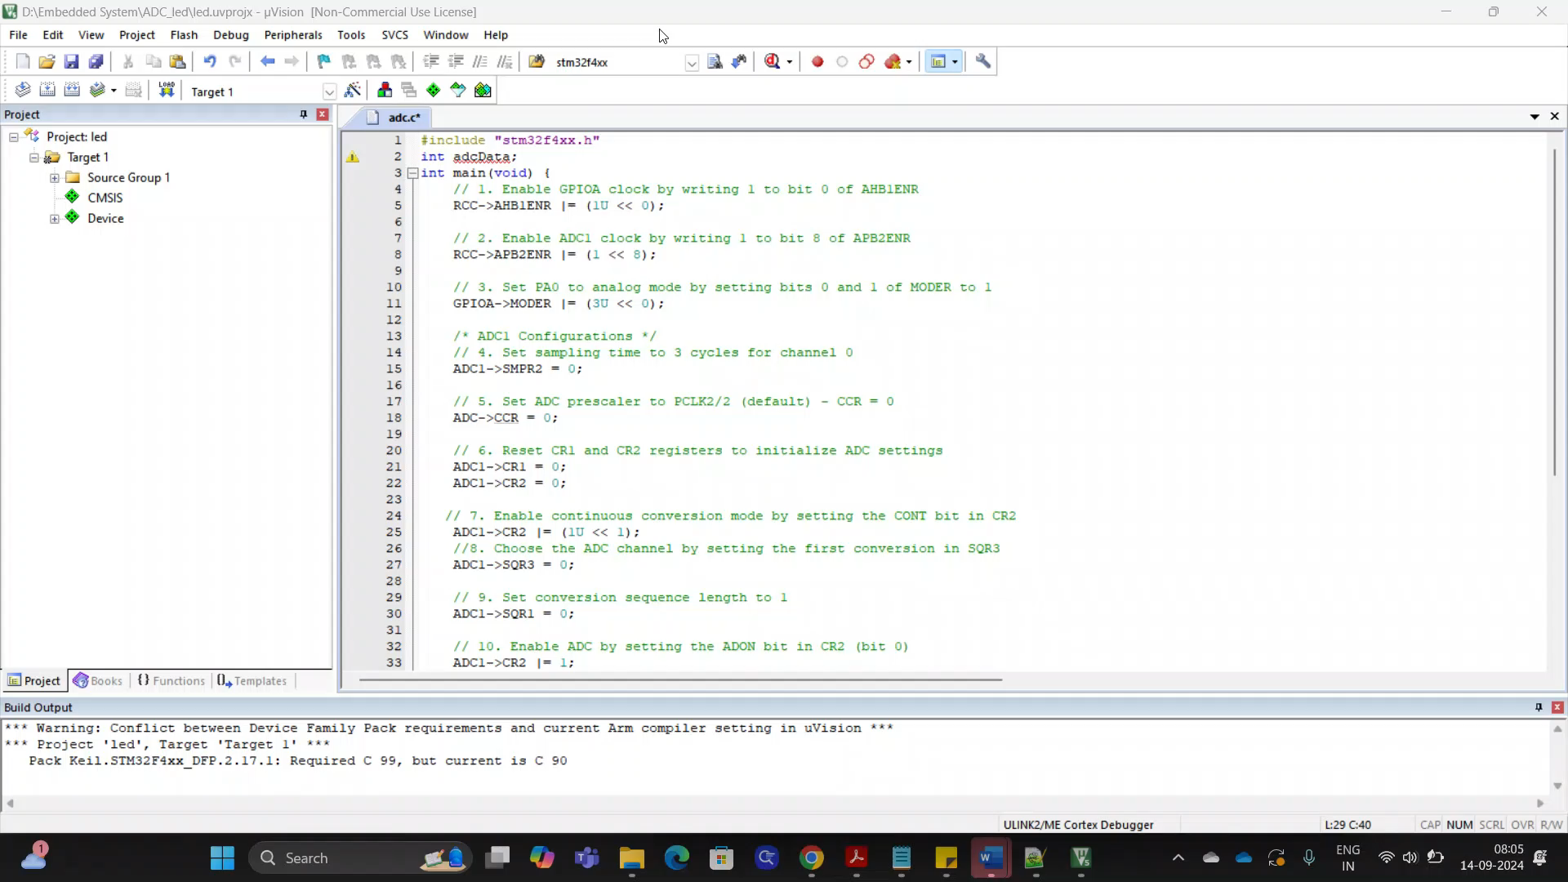
Interfacing a Potentiometer with STM32F401 ADC on PA0 (Channel 0)
Reading the ADC value
Video

Slide 28
Interfacing a Potentiometer with STM32F401 ADC on PA0 (Channel 0) and Control the LED on PC14
Experiment 4.2

Slide 29
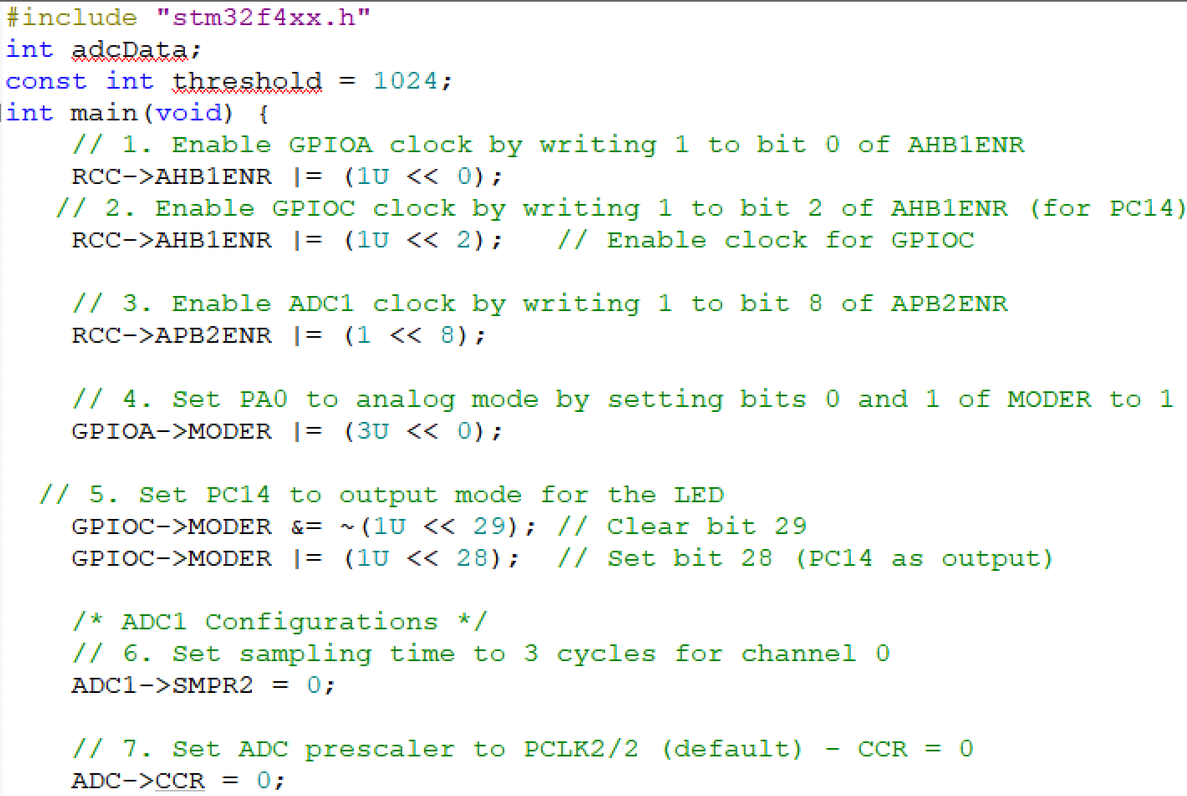
Experiment 4.2

Slide 30
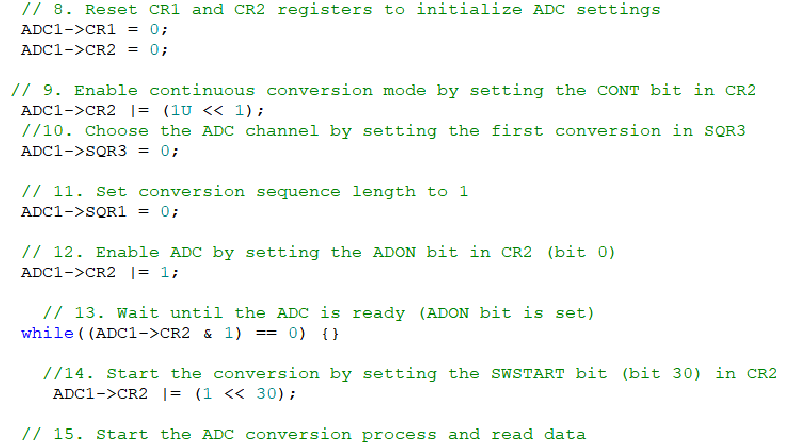
Experiment 4.2

Slide 31
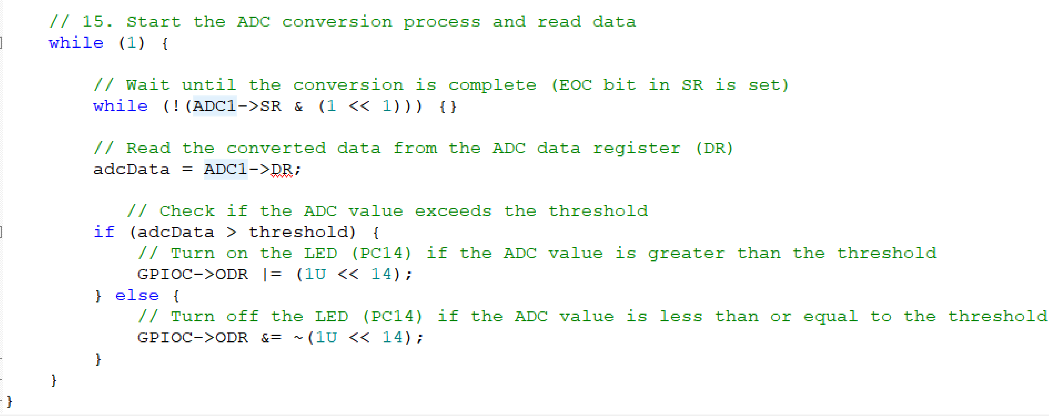
Experiment 4.2

Slide 32
Interfacing a LDR (Light Dependent Resistor) with STM32F401 ADC on PA1 (Channel 1) and Control the LED on PC14
Experiment 4.3

Slide 33
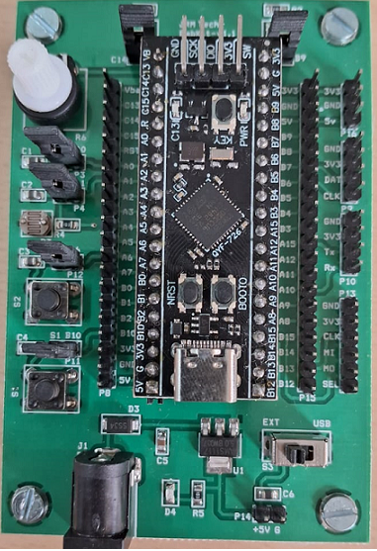
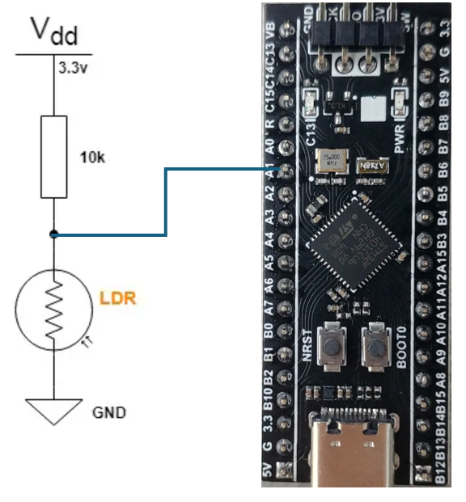
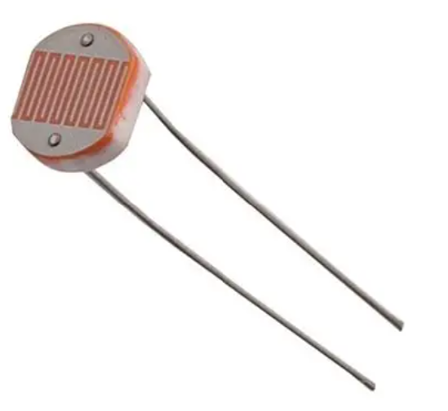
Experiment 4.3
Jumper to PA1
LDR
LDR
An LDR is a light-dependent resistor, it’s an electronic device that is being used for light intensity sensing applications.
The LDR has a relatively low resistance in light, and when the surrounding gets darker the LDR’s resistance significantly increases.
Hence, we can make a voltage divider circuit using the LDR and a fixed resistor and use the microcontroller’s ADC to measure the voltage which indicates the resistance value or the light intensity level.

Slide 34
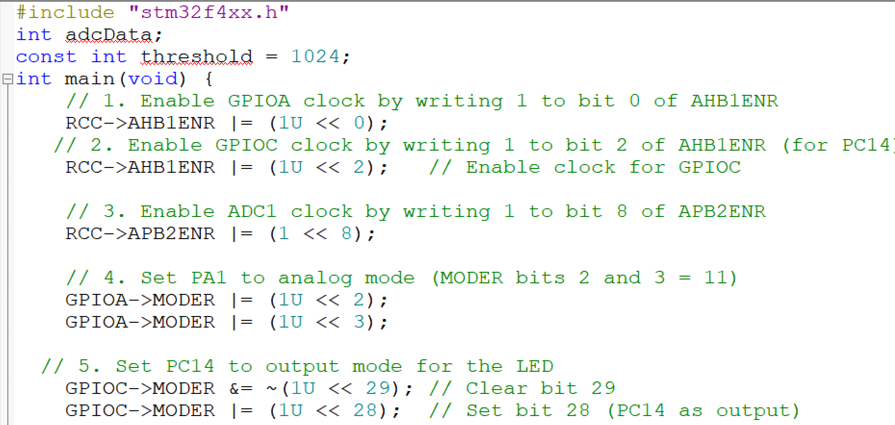
Interfacing a LDR with STM32F401 ADC on PA1 (Channel 1)

Slide 35
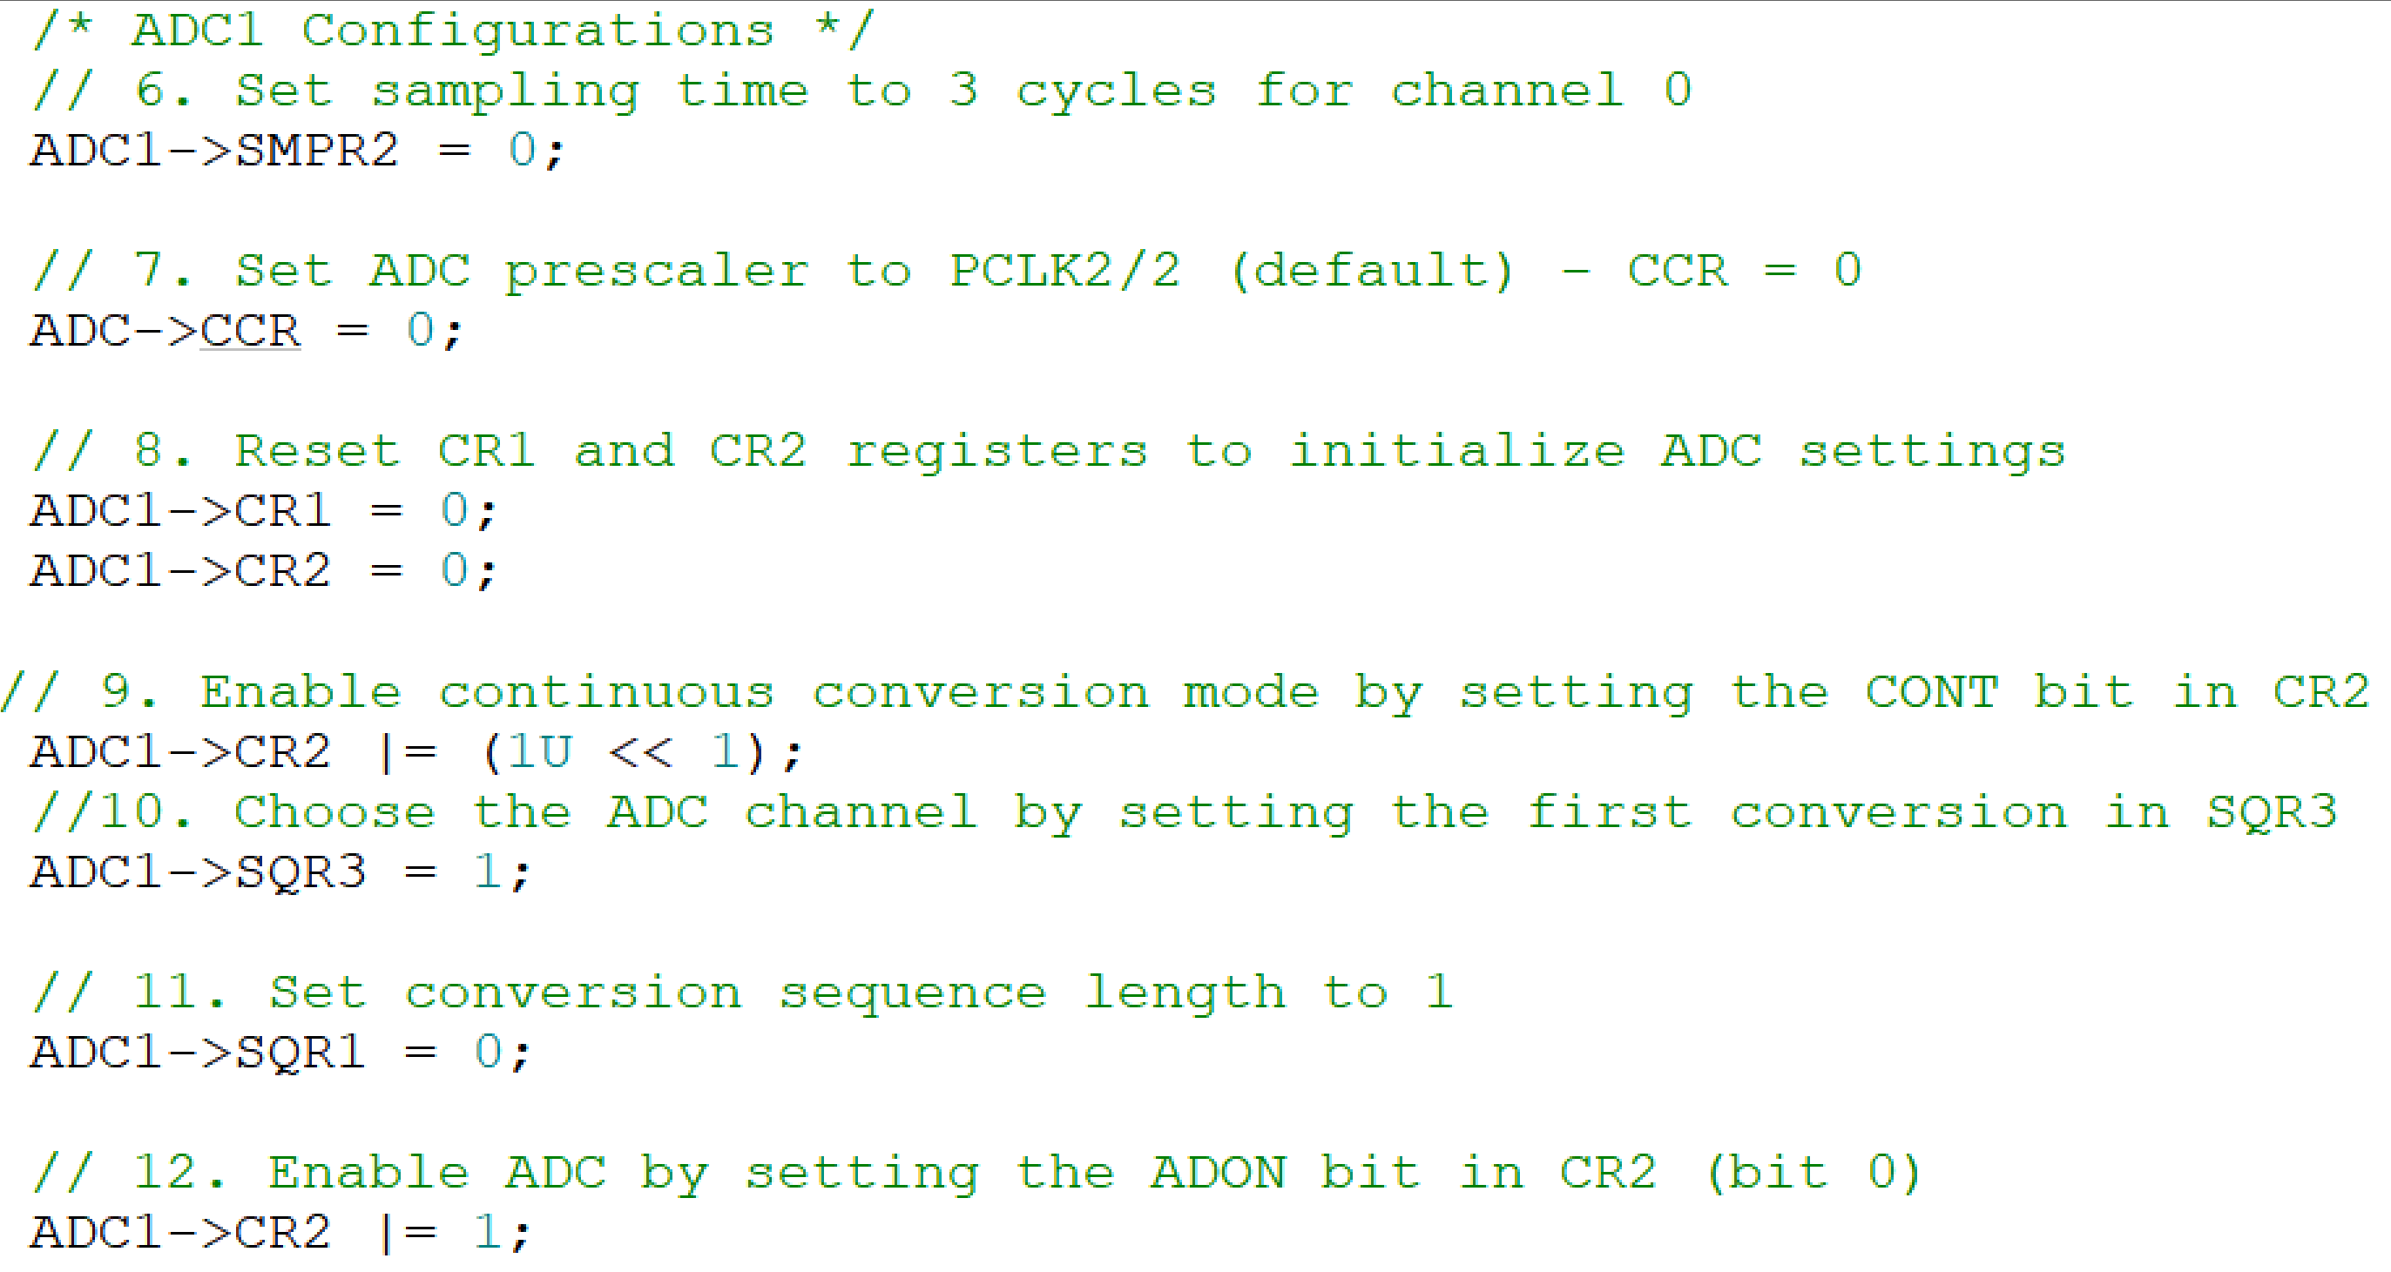
Interfacing a LDR with STM32F401 ADC on PA1 (Channel 1)

Slide 36
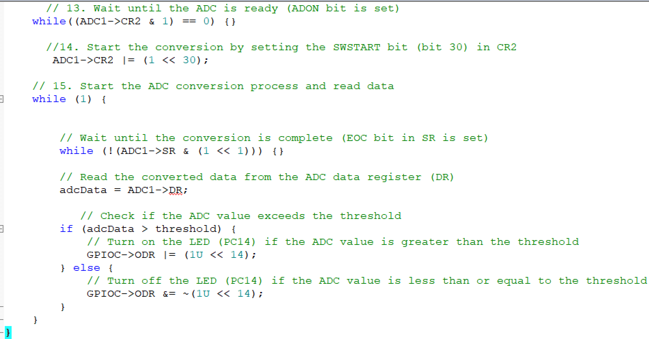
Interfacing a LDR with STM32F401 ADC on PA1 (Channel 1)

Slide 37
Thank You

